Slide 1
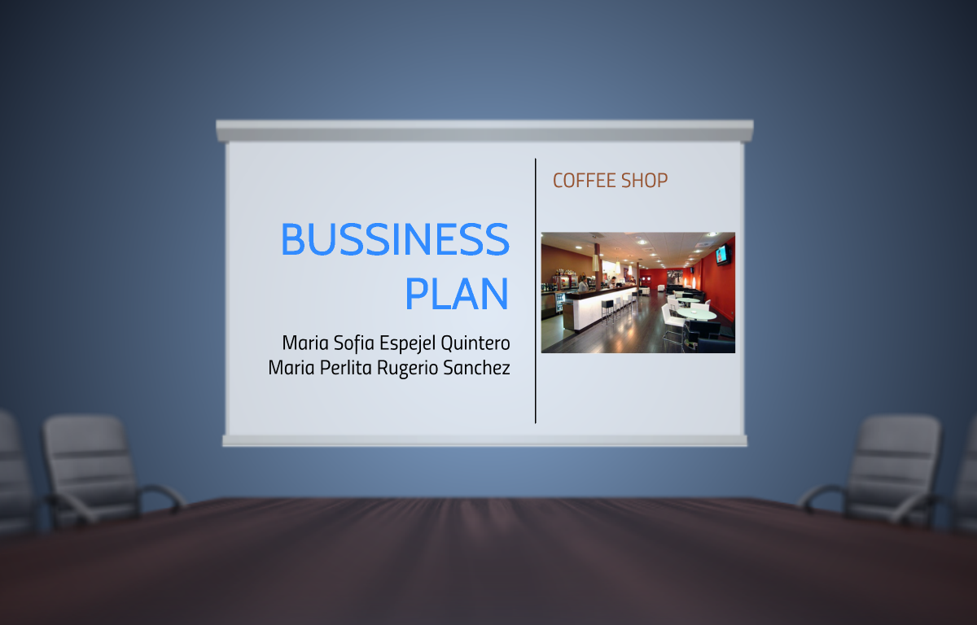
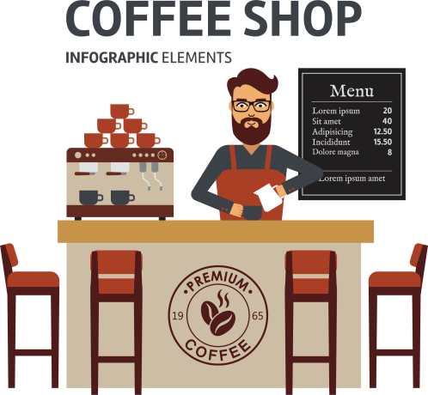

Business Plan
By
Pawan Mahadu Sarule
Class: FYBCA(Sci)

Slide 2



Objective
Profit that allow us to open more branches in all parts of Mexico.

Slide 3

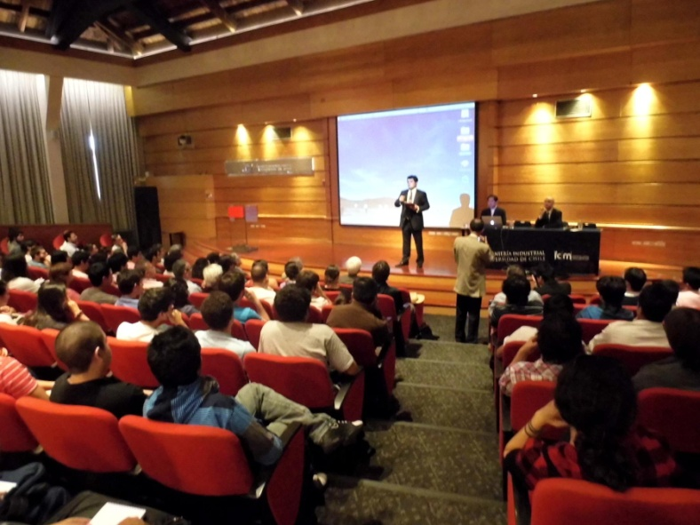
Scope
To present our product in a conference
Providing a quality service at a good cost

Slide 4


Strategies
Offer special prices to customers

Slide 5


Goal
Buy the merchandise in Chiapas

Slide 6



Achieve have a broad menu agree to our consumers

Slide 7



Purpose
We are committed to selling coffee which also meet the need for quality of demanding customers, we will also be using resources and procedures for the best flavor and aroma of our coffee.

Slide 8

